Slide 1
Bear Creek Planned Unit Development
Site Context

Slide 2
Bear Creek Planned Unit Development
Overall Concept Plan

Slide 3
Bear Creek Planned Unit Development
Northern Master Plan Elements

Slide 4
Bear Creek Planned Unit Development
Northern and Central Master Plan Elements

Slide 5
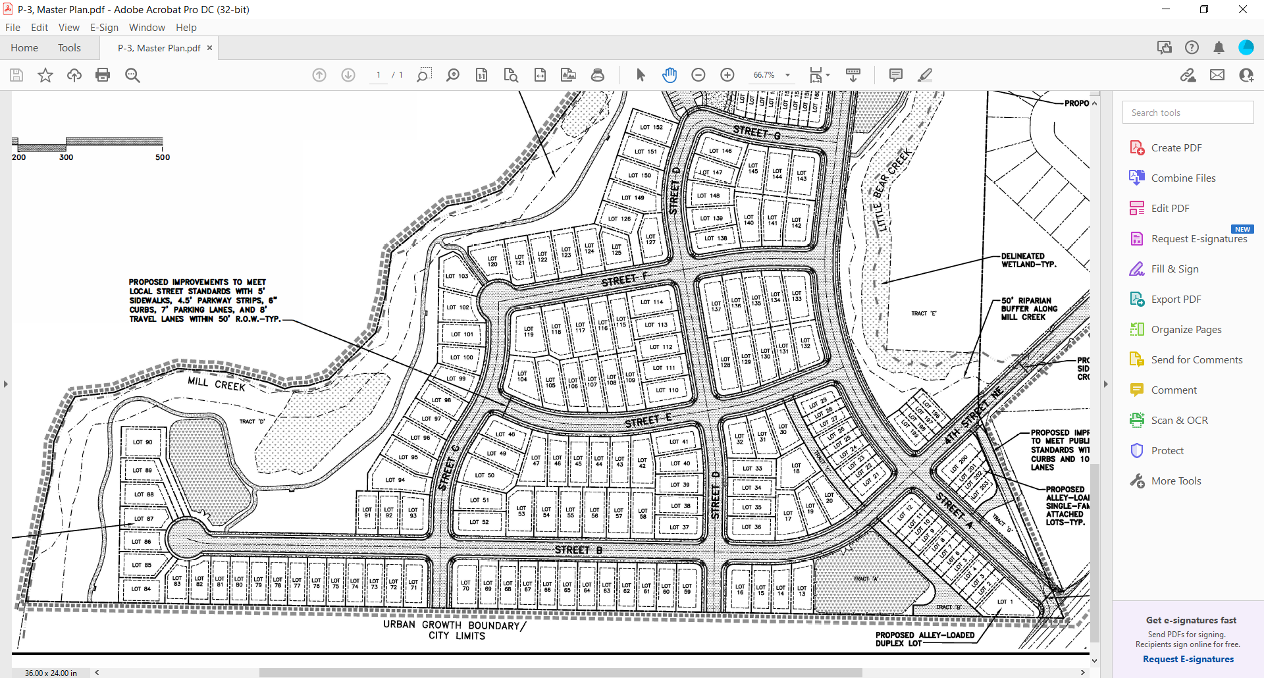
Bear Creek Planned Unit Development
Southern Master Plan Elements

Slide 6
Bear Creek Planned Unit Development
Phasing Plan

Slide 7
Bear Creek Planned Unit Development
Alternate Phasing Plan

Slide 8
Bear Creek Planned Unit Development
Overall Concept Plan

