Slide 1


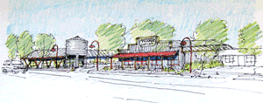
City of Hubbard
FY 2022-23 Proposed Budget Highlights
May 31, 2022
Presented by: Christa Bosserman Wolfe, CPA
Wolfe Consulting, LLC

Slide 2




Balanced Budget of $10.3M

Slide 3
Budget Assumptions
Revenues
  No new revenue sources were included in the budget
  Property tax growth in assessed value of 4%
  State shared revenues estimated from League of Oregon Cities annual report
Expenses
  Personnel:
    All vacant positions budgeted as filled the entire year
    Compensation range increases & step increases
    COLA 7.63% for police union and 4.63% for all other positions
    No increases in PERS this year and level insurances costs
  Materials & Services and Capital Outlay
    Departments budget for increases
    Inflation assumed of 8% over current year costs (for goods, utilities, gasoline, etc.)
    10% increase for liability insurance from CIS
    Reclassed contracted services to professional services (accounting clean up)
    Pay off Sewer Bond

Slide 4
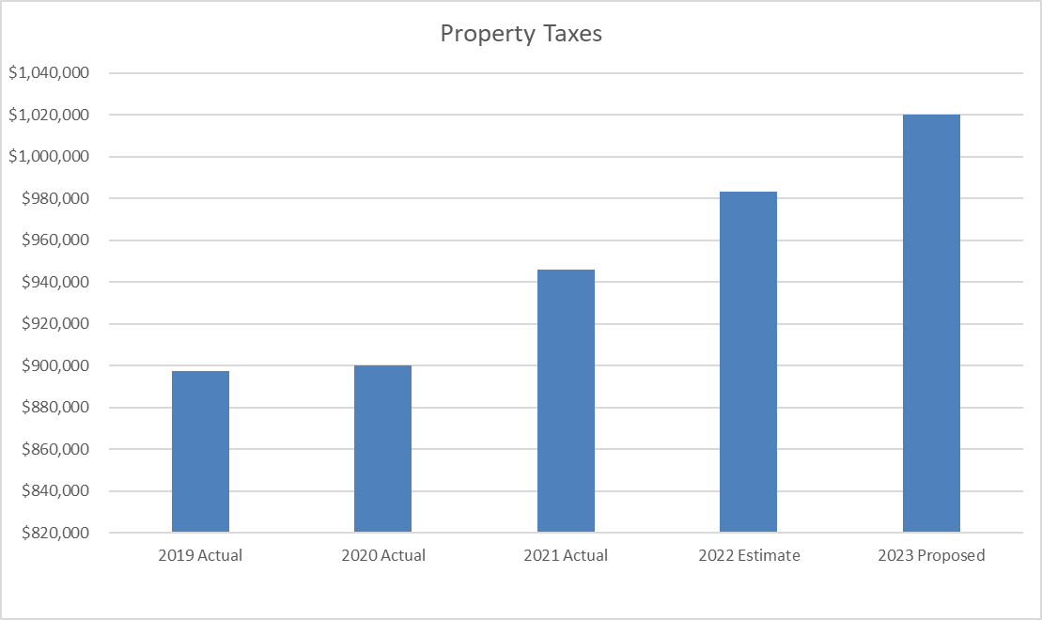
Property Tax History & Projections
FY 2021-22 tax roll total assessed value was $261,613,810, resulting in $1,040,491 total taxes for distribution for the City of Hubbard.
Marion County is forecasting continued growth in assessed value at the rate of 4% per year.

Slide 5
Expenditure Trends
(All Funds Proposed Budget)
Personnel Services
8% increase
$159,705
Materials & Services
10% increase
$114,350
Capital Outlay
11% increase
$107,438

Slide 6
General Fund Operating Surplus (Deficit)
FY 2022-23 projected to be an operating deficit of approximately $267,186 with all vacant positions filled and all other budgets fully expended.
That trend would then continue to grow as other personnel and costs increase.
Factors that would slow or reverse this trend – increasing development and property tax growth, raising rates, or other new revenue sources.

Slide 7

Contingency, Reserves, and
Unappropriated Ending Fund Balance

Slide 8

Operating Contingency
  Operating Funds only
  15% of operating expenditures
  Appropriated by governing body
  Can be spent after moving to another category

Slide 9
Reserves vs Ending Fund Balance
Reserve for Future Expenditures
  Carried forward to subsequent fiscal year
  Other reserves / set asides
  NOT appropriated by governing body
  Can be moved through supplemental budget
Unappropriated Ending Fund Balance
  Covers cash flow after the end of the budget year, until Property Taxes revenues arrive (November)
  NOT appropriated by governing body
  Cannot be used during the fiscal year unless true emergency, such as natural disaster

Slide 10
Ex: General Fund (page 22)

Slide 11
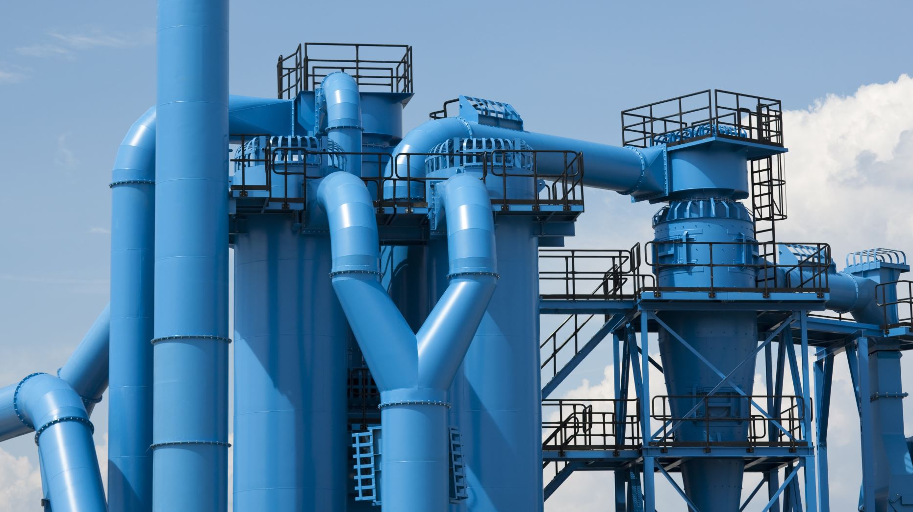
Operational Overhead Allocation

Slide 12
Allocation Methodology
Q: What is Allocated?
A: General Fund Administration and City Council expenses ($256,169).
Q: Which Departments pay overhead?
A: General Fund absorbs overhead for Court, Community Development, Police, and Parks. Street, Sewer, and Water Funds transfer amounts quarterly.
Q: How is Operational Overhead allocation determined?
A: Based on each fund’s operating expenses, excluding capital outlay.

Slide 13

Reserve Fund
(page 35)
13

Slide 14
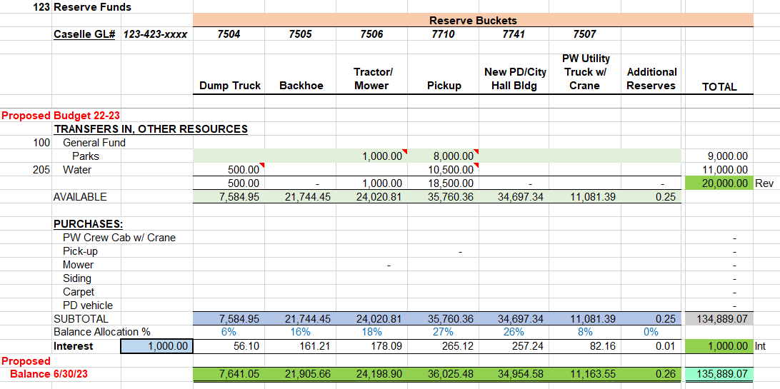
Funding Status Details

Slide 15
Prior Year Recommendation –
Full-time City Administrator
Recruit
Recruit for a full-time City Administrator with a Finance background.
Start
Start with a 2-year contract to ensure that the new structure will work long-term.
Use
Use colleagues and other resources such as League of Oregon Cities for best practices in building a new management structure.
Rely on
Rely on your new manager for managing day-to-day activities and hold them accountable for meeting expectations.

Slide 16
City Administrator
Key Executive Functions needed:
  A bridge between Council and Department Heads to facilitate efficient decision-making in support of Council goals and priorities
  Ensure City Council has the information necessary to make wise and informed decisions
  Manages and supports Dept Heads; leads the team in driving the organization forward
  Budget/Financial management
  Identify opportunities for new funding mechanisms to maintain stability

Slide 17
Recommended Budget Adjustments to the Proposed Budget
Remove Contingency from the non-operating funds and add to Reserve for Future Expenditures.
  No $ impact to the total budget amount. Simply changes lines items/categories.
Increase gas tax revenue in the Street Construction Fund in the amount of $32,949, for a total of $93,000. Offset to Reserve for Future Expenditures
  Impact is an increase to the total budget of $32,949, for a revised total budget of $10,365,187.

Slide 18

QUESTIONS

Slide 19
Public Hearing: FY 2022-23 State Shared Revenues
Qualified to receive state shared revenues by providing:
- police protection,
- street construction/maintenance,
- sewer & storm services,
- utilities, such as water,
- planning, zoning & subdivision control.
Trends remain stable with the exception of the State marijuana $ as these are now paid differently than in prior years and will result in reductions.

Slide 20

Public Hearing: FY 2022-23 Proposed Budget
The City is presenting a proposed budget of $10.3M. The budget is balanced and complies with Oregon Local Budget Law.

Slide 21
Motions to approve the Budget
Property Taxes:
Motion to impose the property tax levy rate of $3.9772 per $1,000 of assessed value.
Budget:
Motion to approve the FY2022-23 proposed budget of $10,365,187, with the recommended changes as presented.

